Slide 1
Visual Management
Notes:
NOTE: Typical training length: 4 hours including one ten-minute break

Slide 2

Other Modules In This Series
5S
Total Productive Maintenance (TPM)
Cell Design/ Production Preparation Process (3P)
Intro to Lean
Kaizen
Kanban
Problem Solving
Poka Yoke Quality Systems
Process Mapping
Single Minute Exchange of Dies (SMED)
Standard Work
Transaction Process Improvement (TPI)
Value Stream Mapping (VSMi/VSMI)
For More Information Please Contact:
Mark DeLuzio, President and CEO
+1.860.234.0915
mark.deluzio@leanhorizons.com
Strategically Creating Value Through the Elimination of Waste
2

Slide 3
This document contains confidential
and proprietary information owned
by Lean Horizons Consulting, LLC.
Any disclosure, use, copying or
distribution of this information without the express written consent of Lean Horizons Consulting is strictly prohibited.

Slide 4
Ground Rules for Event
Safety first (use personal protective equipment)
Active participation by all
Start and end on time
All electronic gadgets (phones, pagers, etc) turned to “off” or “silent”
Computers to be used only when instructed
Keep an open mind to change
Don’t let “perfect” get in the way of “better”
4
Notes:
DO: Perform Group Introductions. Pick an ice-breaker or exercise to warm the team up to the event. (Icebreaker Example: Everyone uses their name tent and writes a “Personal License Plate” in which they have 2 minutes to creatively use a total of 7 letters or numbers to tell us something about themselves. Examples “LV2SAIL” OR “DADOV5”
DO: Review Event Ground Rules.
ASK: “Does anyone have any rules they would like to see added?”
ASK: “Does everyone agree to these?”

Slide 5
Visual Management
Goal of Visual Management Module:
To assess the value and effectiveness of new and existing visual controls
and effectively utilize visual controls as management tools.
Managing
with
Visual
Controls
Principles
of Good
Visual
Controls
Review and
Summary
5
Notes:
DO: Introduce the notion of Visual Management and the goal of this event.
It is a method to assess the status of any operation or area with little or no knowledge of the process and be able to make a determination on the status in moments.

Slide 6
Exercise: Define Visual Management
Objective
Define visual management in your own words.
Instructions
Time to Complete
Individually, write down your own definition
of the term visual management.
5 Minutes
Deliverable
Share answer with class
6
Notes:
NOTE: We want the learners to complete the exercise by simply looking at the two words together: “visual” and “management” and write what these mean to them.
DO: Capture answers on a flipchart.
DO: Refer back to these answers when reviewing the following slides that define visual management.

Slide 7
Visual Management Defined
Provides real-time information and feedback regarding the status of the company
Communicates the shared vision of the business and how each individual contributes towards that success
Provides a clear and common understanding of goals and metrics
Presents the same information to everyone
Maintains focus on the critical few metrics
Drives ownership and accountability from the lowest possible level in the organization
Notes:
SAY: “How do we develop processes so that people understand if “their” process is getting better or worse? Visual Management drives ownership, awareness and accountability from the lowest possible level in the organization…visible (in real time…at the point of occurrence) to the highest level in the organization.”

Slide 8
Benefits of Visual Management
Cleaner and safer workplace
Less wasted time
Improved quality
Improved morale
Ties into the 5S strategy (4th "S" - Standardize)
Makes abnormalities and waste clear to everyone
Moves from having only "specialists" understand to an environment where everyone understands
Notes:
DO: Ask the class for examples of how Visual Management impacts each of these.

Slide 9
Importance of Visual Management to a Lean Enterprise
Visual Management is one of the key fundamentals to successfully transforming your company into a Lean Enterprise
Visual Management provides both real-time and predictive information on the health of your business
Visual Management is a key enabler for Supervisors, Managers and Executives
Develop Strategic
Business Imperatives
Profitable Growth
Enterprise Optimization
Value Stream Optimization
Lean Fundamentals
Waste Elimination Tools
Lean Infrastructure
Notes:
DO: Cover points on the slide. Speak to how Visual Management is a key fundamental to the success of a lean enterprise.

Slide 10
Visual Controls Defined
Means, devices, or mechanisms that enable Visual Management
Make problems or abnormal conditions visible to everyone in order for corrective action to be taken
Display the current status in an easy-to-read format
Provide instruction
Communicate information
Provide immediate feedback
Notes:
DO: Cover points on slide defining visual controls

Slide 11

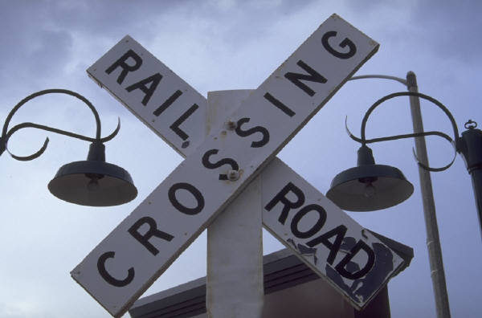
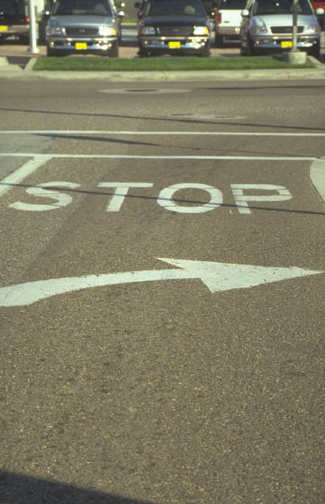
Visual Management in Our World
Visual controls are all around us
How many visual controls can you name in use at home and at work?
Notes:
SAY: “Visual management is common in our everyday world, but not in our manufacturing and office environments. Too often, we must ‘go talk to somebody’ to know what is going on: are we ahead, are we behind, are we better than yesterday, are we better than last month?
SAY: “The goal of visual management is to determine abnormal from normal at a glance (within 5 seconds).”
Can you determine:
* Are we ahead of or behind schedule?
* Are we better today than last week? Last month?
* Do we know the top issues affecting our area?
* Are we doing anything to eliminate them from occurring again?
And, ultimately, do you (supervisor/manager) need to get involved?”

Slide 12
Exercise: Visual Controls
Objective
Demonstrate effectiveness of visual controls.
Instructions
Time to Complete
In small groups you will be handed instructions
for assembly.
With a stopwatch, time the length of time from
opening the instructions to the completion and
quality check of assembly.
Assemble the instructions as a team.
20 Minutes
Deliverable
Share results times for
all teams.
Discuss take-aways.
12
Notes:
NOTE: This exercise can be replicated with different supplies (ie: supplies from an office – paper clips, folding paper, drawing lines, cutting, etc.) – this would need to be prepared in advance of the event.
DO: Break the group into teams of 4 (keep the teams small so that everyone can be involved).
Pass out the contents of the Lego Visual Management exercise. Each group should get one envelope of instruction and one bag of lego contents with a stopwatch.
The teams are to assemble the figure according to the instructions. Position the teams in the room so that they are not too close to each other (do not want to reveal during the assembly that one team has visual directions).
Make sure you examine the figures for accuracy and quality when a team says they are “finished”.
At the end of the exercise have each team report their times and their experiences with this exercise. Ask the team who completed fastest to show their instructions to the group.
Ask for key take-aways regarding the use of visual controls.

Slide 13
Managing with Visual Controls
Managing with
Visual Controls
Principles
Review &
Summary
Objectives:
Define current management tools
Define “gemba” and identify the importance of “gemba”
Discuss the steps of the visual management improvement cycle
Identify how visual controls drive immediate action
Notes:
DO: Review section objectives on slide.

Slide 14
Exercise: Current Management Tools
Managing With Visual Controls
Objective
List and define current management tools you use today.
Instructions
Time to Complete
Identify the top 3 current management tools that
you use today to manage the business.
Note – we will refer to this list later in the module
5 Minutes
Deliverable
Share list
14
Notes:
DO: Ask the group to write these tools in their books. When complete, capture answers on a flipchart.

Slide 15
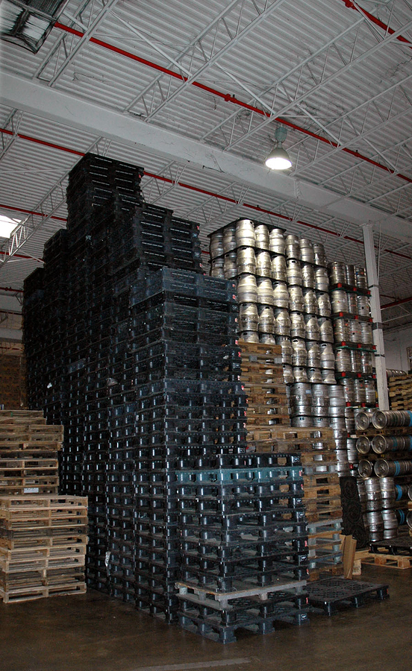
What is “Gemba”?
Managing With Visual Controls
Gemba is a Japanese term meaning, “the place where the truth can be found”
Involves going to the actual place, talking with the actual people, and viewing the actual results or situation
Reprinted with permission from BigPhotoStock.com
Notes:
SAY: “We need to get away from using computer-generated reports that are discussed in meetings that take place in a conference room. How will we fully understand what the situation is if we don’t see it for ourselves? How will we get to root cause?” The idea is that to be customer-driven, one must go to the customer's gemba to understand his problems and opportunities, using all one's senses to gather and process data.
Gemba = Genchi Gembhutsu – a “go and see” mindset that makes no assumptions on what it going on. The aim to find out everything that happens by physically viewing what happens at the points of origin.
At Toyota they have a very high proportion of their management on the shop floor (the Gemba) so that supervisors can be intimately involved in quality issues as they arise. Their presence in the Gemba informs their decision making and speeds resolution of problems. This Gemba attitude is driven by the belief that all customer value is created in the Gemba and it is therefore the qualities of the Gemba which will determine the success of the company.

Slide 16
Exercise: Gemba
Managing With Visual Controls
Objective
Demonstrate the importance of gemba.
Instructions
Time to Complete
Split the entire class into groups of 5.
Each team will report to a different area and
will receive further instruction from the
facilitator.
Report back in 15 minutes with results
15 Minutes
Deliverable
Share list
16
Notes:
INSTRUCTIONS:
Split the class into small teams (keep at around 5).
Keep one team in the classroom. Send another team to the lobby of the facility (BUT DO NOT TELL THE OTHER TEAM THAT THIS TEAM IS GOING TO THE LOBBY). If there are more than 2 teams, send the other teams to an office or other conference space – but keep them apart.
Once the teams are separated, give individual instructions. They are to draw the lobby of their facility in as much detail as they can. They are not allowed to leave their designated space (ie: other teams cannot go down to the lobby during the exercise “to refresh their memory”. The more detailed the better. They have 15 minutes to complete this and return to share their drawings.
When the 15 minutes is complete – they are to return and hang their drawings.
The team from the lobby (gemba) should have the most detailed drawing. Point out differences in detail.
Discuss key takeaways – how does this exercise relate to how you solve problems in your business?
SAY: “When we go to gemba, we look to visual management to tell us what is happening.”

Slide 17
Visual Management = Improvement Cycle
Managing With Visual Controls
Abnormality
Occurs
Standardize
Improvement
Visual Tools
Kaizen
Make
Improvement
Discover
Abnormality
Look for
Root Cause
Notes:
SAY: “Visual management is a critical component of the improvement cycle–both the beginning and the end.
- Visual management helps one ‘see’ where the problems (opportunities) are. It points us in the direction of the abnormality.
- Once we know where the problem is, we can then use the lean tools to look for the root cause (Pareto, Histogram, 5 why’s, TAKT Time, Time Observation, Bar Charts, Standard Work, Spaghetti diagram, etc. are a subset of the possible options)
- Implement solutions: Ultimately this is where the ‘rubber meets the road.’ In order to expect a different outcome, “what waste have you eliminated?”
- Standardize improvement: Once a better method has been developed, how will we sustain? How will we proliferate? How will we deploy?
“If” an abnormality occurs, how will we know? When will we know? Timeliness is key to prevent erosion of the new method. You MUST be able to determine ‘abnormal from normal’ in real time.
Good visual management tools will help us do this.”

Slide 18
Visual Controls drive immediate action
Managing With Visual Controls
By having an organized system and visual system in place,
one can quickly take corrective action
These actions would be short-term,
intended to take care of the customer now
Longer-term actions need to be taken to ensure the root cause is addressed so the problem can be prevented from re-occurrence
Document and standardize the solutions that address root cause
Ultimately, Visual Controls should be used as predictive management tools
  Can identify or stop a problem before it happens
  Can identify when the “bar is set too low” and we need to raise our goals
Notes:
SAY: Established visual management can allow us to take immediate action to solve problems.
SAY: “An analogy would be when we fall on the pavement and scrape our knee – we want to stop the bleeding – now! We take immediate actions to stop the bleeding.”
ASK: “But more importantly, after we stop the bleeding, what do we want to do?”
SAY: “We want to search for the root cause and implement actions to ensure that situation is never repeated. So if the root cause was uneven pavement, we may schedule to have the sidewalk re-paved so that it is smooth and even. Or if it was icy conditions, we could institute a shoveling and sand-spreading schedule when snow or ice storms occur as well as place caution signs on the sidewalk, etc…”
SAY: “Ultimately, we want to drive Visual Management to be predictive management tools so that we can identify a potential problem and take action to correct it – BEFORE it ever happens. With good visual management in place – this can happen.”

Slide 19
Exercise: Traditional Management Tools vs. Visual Management
Managing With Visual Controls
Objective
Define visual management in your own words.
Instructions
Time to Complete
In small groups, review existing list of management
tools you use today from previous exercise.
Recreate chart on following slide on chart paper,
and plot your existing tools today on the chart.
15 Minutes
Deliverable
Discuss with the class
your findings
19

Slide 20
Chart for Exercise
Managing With Visual Controls
 | Non-Visual | Visual
Predictive
Real-time
Historical

Slide 21
Using Visual Controls as Predictive Tools
Managing With Visual Controls
 | Non-Visual | Visual
Predictive |  | We want to move our management tools in this direction!
Real-time
Historical
Notes:
ALLOW FOR TEN MINUTE BREAK AT THE COMPLETION OF THIS SLIDE/SECTION.

Slide 22
Principles of Good Visual Controls
Managing with
Visual Controls
Principles
Review &
Summary
Objectives:
Identify principles of good visual controls
Identify degrees of visual control response
Identify types of visual management tools
Discuss value of visual management tools in action
Notes:
DO: Review section objectives on slide.

Slide 23
Principles of Good Visual Controls
Principles of Good Visual Control
Points Descriptions
1
Understandable
Consider the audience
What action is expected?
2
Indicate a Goal
Measure actual to goal
Separate real-time from historical
3
“At-a-Glance”
Use pictures, graphs, examples, etc. where possible
4
Standardized
(over time)
Everyone should know what they are looking at
Strive for a company-wide approach

Slide 24
Visual Control Response
Principles of Good Visual Control
Escalating Degrees of Response:
  Operator – immediately
  Supervisor – within minutes
  Technical Support – within minutes
  Management – within ten minutes
Notes:
SAY: “In Japan, these are the guidelines for ‘responsiveness.’ Visual management in the office has the same objective, however the responsiveness levels are much worse.”

Slide 25



Visual Management Tools
Principles of Good Visual Control
Types of Visuals
Sign boarding
Line Demarcations
  Floors & Aisles
  Stack Height Limits
Andon Lamps
Kanban
Production Management Boards
Standard Work Charts
Defective Item Displays
Reprinted with permission from BigPhotoStock.com
Notes:
SAY: “There are different types of visual management tools:
Signboarding: Clear labeling and signage for everything
Line Demarcations: Used to establish the ‘rules of engagement’ in a given area. Also tied to safety, productivity and individual performance
Andon Lamps: “signal” from the work area to a supervisor (process owner). Typically uses “green-yellow-red” as the indicators
Kanban: Japanese word for signal. Typically used to “signal” the need for more materials or a certain type of material. There are many types of Kanban: Production Kanban (used to signal the need to produce more goods), Replenishment Kanban (used to signal the need to replenish stock at a location), Reorder Kanban (used to signal the reorder of materials from a supplier), Transport Kanban (used to signal the movement of materials from one location to another)
Production Management Boards: used to monitor hour by hour ‘cell’ performance (office or shop). Includes “Plan,” “Actual,” “Difference,” and “Comments” areas (typically filled out hourly)
Standard Work Charts: the forms used to document Standard Work in a cell or work area. Typically includes Standard Work Combination Sheets, TAKT Time Calculation, and Standard Work Layout. (Capacity sheets are also used where appropriate.)
Defective Item Displays: just as it sounds, examples of ‘bad products.”

Slide 26
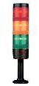
Visual Management Tools
Principles of Good Visual Control
Lights installed on equipment, lines or cells to indicate the status of production
Possible uses:
  Machine abnormality
  Machine re-supply
  Operator status to takt time
Color Coding – teams will specify the meaning of lights based on an area’s needs:
  Red—maintenance is needed immediately
  Yellow—the team is running out of parts
  Green—the team is running parts
  Teams will specify the meaning of the lights based on an area’s needs
Andon Lights
Notes:
NOTE: Stack-lights/Andons should also be used in the office. Instead of using lights, use “bicycle flags” (green – yellow – red) or construction paper to ‘signal’ operating condition of the cell (e.g. quoting cell, order entry cell, invoicing cell)
…remember this is a tool to enable a supervisor to determine abnormal from normal (in 5 seconds or less)

Slide 27
Visual Management Tools
Principles of Good Visual Control
Gauges and Indicators
Abnormal situation should be understood at a glance
No need for interpretation
20
Safe
30
10
40
0
FULL
Notes:
SAY: “This is a very common technique used in TPM events on critical equipment (heat treat furnaces, paint lines, wash systems, CNC equipment, bathrooms, etc.).”

Slide 28
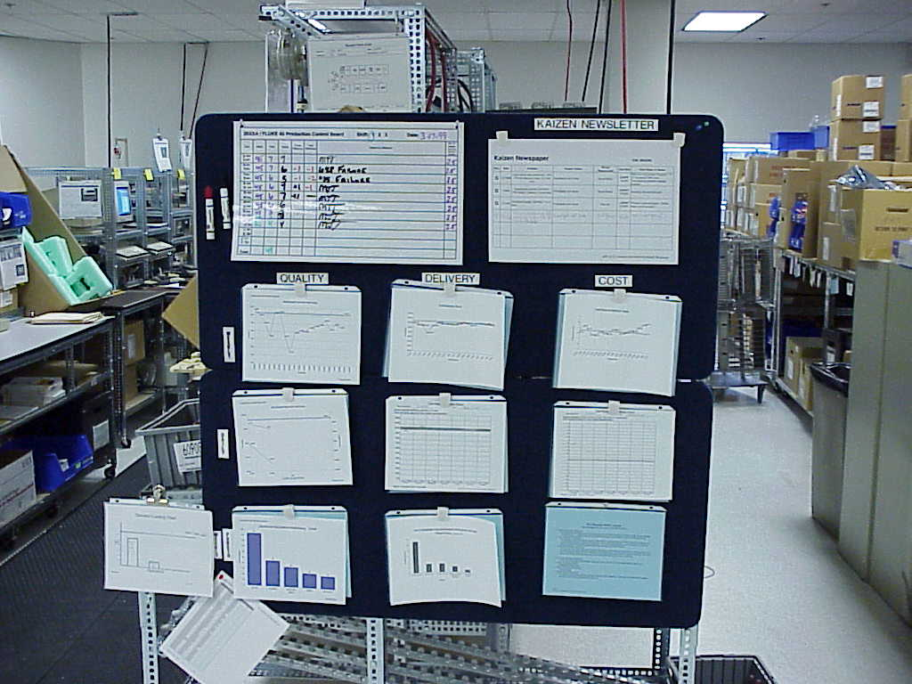
Visual Management Tools
Principles of Good Visual Control
Key Performance Indicator Board
Team board that highlights the progress of a team in meeting key goals for Safety, Quality, Delivery and Cost
Boards are used to track and highlight countermeasures
Notes:
SAY: “Example of “key metrics” board for a cell.
- Production Control board
- Standard Work Sheets (SOPs)
- Quality, Cost and Delivery performance
- Top concerns/issues in the cell and what’s being done to fix them
- Pareto of top issues”

Slide 29
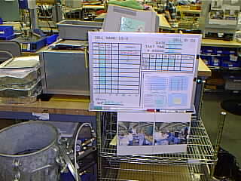
Visual Management Tools
Principles of Good Visual Control
Hourly Count Boards
A board used to track the production performance on an hourly basis against customer needs
Used to identify issues and establish countermeasures in real time

Slide 30
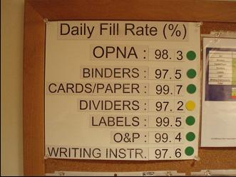
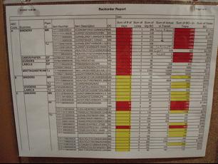
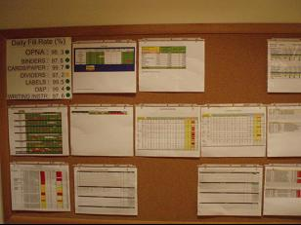
Visual Management Examples
Principles of Good Visual Control

Slide 31
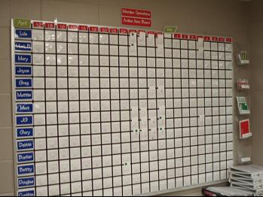
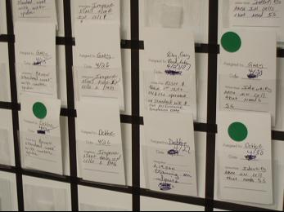
Visual Management Examples
Principles of Good Visual Control

Slide 32
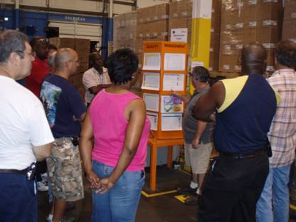
Visual Management Examples
Principles of Good Visual Control

Slide 33
Exercise: Using Visual Controls as Management Tools
Managing With Visual Controls
Objective
Identify and discuss the value of visual management tools in action.
Instructions
Time to Complete
In pairs, view the picture on the following page and
discuss the various forms of visual management
and controls that you see as well as their value.
10 Minutes
Deliverable
Report answers back to
class
33

Slide 34
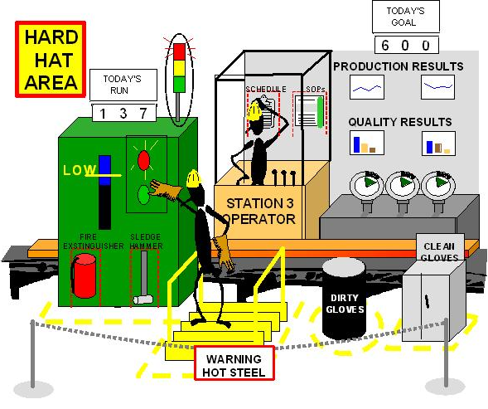
Comment on the value of the Visual Management used below
Principles of Good Visual Control
Notes:
ASK: “What do you see?”
POSSIBLE ANSWERS:
- Safety: Warning signs: hard hat, hot steel, yellow markings on floor
- Quality: dirty gloves, clean gloves, Standard Work, SOPs
- TPM (quality): “low” Indicator lights, Green marking on gages, production results
- History: trend charts for quality, production
- “Real Time” awareness: Stack Lights (Green-Yellow-Red). Is the machine performing to expectation?
- Discipline to standard: SOPs, yellow markings on floor, updated charts

Slide 35
Summary and Review of Visual Management
Managing with
Visual Controls
Principles
Review &
Summary
Objectives:
Identify common pitfalls
Review key learnings
Complete personal action plan
Review summary of Visual Management
Notes:
DO: Review section objectives on slide.

Slide 36
Visual Management Pitfalls
Review and Summary
Typical Visual Management pitfalls occur when Visual Management:
  Only consists of monthly management charts and graphs
  Utilizes computer-generated tools only
  Is backward-looking, historical
  ONLY consists of production status boards
  Is used for reporting and NOT action
Notes:
DO: Review these common pitfalls. Ask if they have seen others. Have the group discuss their experiences with any of these pitfalls.

Slide 37
Review Exercise
Review and Summary
2 Minute Review
  In pairs, or in small groups, spend 2 minutes discussing key learnings and take-aways from this event thus far
  One person from each group will share one learning that was discussed with the rest of the class

Slide 38
Exercise: Personal Action Plan
Review and Summary
Objective
Complete personal action plan that will apply learnings from this session.
Instructions
Time to Complete
In pairs, view the picture on the following page and
discuss the various forms of visual management
and controls that you see as well as their value.
10 Minutes
Deliverable
Report answers back to
class
38

Slide 39
Personal Action Plan
Review and Summary
PERSONAL VISUAL MANAGEMENT ACTION PLAN
Item # | Action | Owner | By When | Status

Slide 40
Visual Management Summary
Review and Summary
Provides real-time information and feedback regarding the status of the company
Communicates the shared vision of the business with the understanding of how each individual contributes towards that success
Provides a clear and common understanding of goals and metrics
Presents the same information to everyone
Maintains focus on the critical few metrics and what must be
done to succeed
Is critical to establishing a lean infrastructure in your business
Notes:
DO: Review key summary points.

Slide 41
Other Modules In This Series:
5S
Standard Work
Total Productive Maintenance (TPM)
Cell Design/ Production Preparation Process (3P)
Intro to Lean
Kaizen
Kanban
Problem Solving
Poka Yoke Quality Systems
Process Mapping
Single Minute Exchange of Dies (SMED)
Transaction Process Improvement (TPI)
Value Stream Mapping (VSM/VSMi)
Visual Management
For More Information Please Contact:
Mark DeLuzio, President and CEO
+1.860.234.0915
mark.deluzio@leanhorizons.com
Strategically Creating Value Through the Elimination of Waste
41

Slide 42
File Revision Log
Rev. | Description of Change | Date mm/dd/yy | Revised by Initials
2.3 | Sl. 30-32: Added new slides Sl. 37: Typographical correction Sl. 42: File Rev Log added | 10/22/08 | SJD

